Slide 1

Technology: Python
Performance Analysis of Intrusion Detection Systems Using a Feature Selection Method

Slide 2
INDEX
Abstract
Introduction
Literature review
Existing Method
Drawbacks
Proposed method
Advantages
Implementation
Modules
Hardware and Software Requirements
Algorithms
UML Diagrams
Results
Conclusion
References

Slide 3
ABSTRACT
Computer networks intrusion detection systems (IDSs) and intrusion prevention systems (IPSs) are critical aspects that contribute to the success of an organization. Over the past years, IDSs and IPSs using different approaches have been developed and implemented to ensure that computer networks within enterprises are secure, reliable and available. In this paper, we focus on IDSs that are built using machine learning (ML) techniques. IDSs based on ML methods are effective and accurate in detecting networks attacks. However, the performance of these systems decreases for high dimensional data spaces. Therefore, it is crucial to implement an appropriate feature extraction method that can prune some of the features that do not possess a great impact in the classifcation process. Moreover, many of the ML based IDSs suffer from an increase in false positive rate and a low detection accuracy when the models are trained on highly imbalanced datasets. In this paper, we present an analysis the UNSW-NB15 intrusion detection dataset that will be used for training and testing our models.

Slide 4
Moreover, we apply a flter-based feature reduction technique using the XGBoost algorithm. We then implement the following ML approaches using the reduced feature space: Support Vector Machine (SVM), k-Nearest-Neighbour (KNN), Logistic Regression (LR), Artifcial Neural Network (ANN) and Decision Tree (DT). In our experiments, we considered both the binary and multiclass classification configurations. The results demonstrated that the XGBoost-based feature selection method allows for methods such as the DT to increase its test accuracy for the binary classification scheme.
Keywords: Machine learning, Feature engineering, Computer networks, Intrusion detection.

Slide 5
INTRODUCTION
The rapid pace at which technologies such as the Internet, Internet-of-Tings (IoT) and communication systems is advancing has caused hackers to evolve with a higher velocity in terms of their capabilities. These criminals strive to discover new ways to compromise computer networks security. Therefore, Intrusion Detection Systems (IDSs) inherently become critical components in a computer network. An IDS is defend as a hardware or a software system that monitors an organization’s computer network for imminent and potential threats or attacks. Moreover, an IDS is capable of responding to any malicious transactions and report them accordingly. IDSs are categorized in 3 broad classes, namely, node or host based IDS (HIDS) network or distributed IDS (DIDS or NIDS) and Hybrid IDS (HYIDS) this classification is based on the specific IDS operation philosophy. HIDS runs on a single node computer system and it is concerned with the security related to its host. In contrast, a DIDS runs on a distributed computer network and analyses the traffic at the network level for suspicious activities.

Slide 6
A signature-based IDS uses an existing data store of previously intercepted attacks in order to detect intrusions. In contrast, an anomaly-based IDS is concerned with the behaviour of the network. It constantly checks for activities that constitute unusual behaviour and fags them. Finally, hybrid based IDS is a combination of both anomaly-based and signature-based IDSs. The primary philosophical design goal of an IDS is to minimise instances of false positive alarms and to increase its detection accuracy. Therefore, the design and implementation of any IDS must take that philosophy in consideration. In recent years, Machine Learning (ML) based IDSs have emerged as the leading systems in the intrusion detection research domain. ML gives systems the ability of learning and improving by using previous data. In other words, ML based computer programs do not need to be explicitly engineered (programmed). They are capable of learning by themselves [8]. Broadly speaking, there exist the following sorts of ML philosophies, namely, supervised ML and unsupervised ML. In the case of supervised ML, models are learned using data that is labelled. In the instance of unsupervised ML, the data that is used to train models is unstructured (unlabelled).

Slide 7
LITERATURE REVIEW
S. No | Journal Type with year | Authors | Title | Outcomes
1 | IEEE, 2020 | Ribeiro J, Saghezchi FB, Mantas G, Rodriguez J, Abd-Alhameed RA | Hidroid: prototyping a behavioral host-based intrusion detection and prevention system for android | In this paper, we develop a novel Host-based IDPS for Android (HIDROID), which runs completely on a mobile device, with a minimal computation burden
2 | IEEE, 2015 | Van NTT, Thinh TN | Accelerating anomaly-based IDS using neural network on GPU | In this paper, we used Neural Network technology to classify normal or abnormal behaviours.
3 | Journal, 2015 | Jabez J, Muthukumar B | Intrusion detection system (IDS): anomaly detection using outlier detection approach | This research work proposed a new approach called outlier detection where, the anomaly dataset is measured by the Neighbourhood Outlier Factor (NOF)
4 | ICDCN, 2009 | Neelakantan S, Rao S. | A threat-aware anomaly-based intrusion-detection approach for obtaining network-specifc useful alarms | In this paper, we present a Threat-Aware Anomaly-Based IDS model for obtaining network-specific useful alarms

Slide 8
EXISTING METHOD
The increasing growth of machine learning, computer techniques divided into traditional methods and machine learning methods. This section describes the related works of performance of Intrusion Detection systems and how machine learning methods are better than traditional methods. The existing method in this project have a certain flow is used for model development. SVM and ANN are used algorithms in existing system. But it requires large memory and result is not accurate.
DISADVANTAGES
Accuracy low
Requires more time
Difficult to handle

Slide 9
PROPOSED METHOD
Much research has been done on studying performance analysis of intrusion detection of systems. In early days if have to check the system performance it’s a time taking process. We can detect the system performance by using Decision tree, KNN (K-Nearest Neighbour), LR (Logistic Regression), Decision Tree, XGBoost. To get better accuracy we used Decision Tree algorithm. Bu using these machine learning techniques we can easily detect the system performance like weather the system is attacked or not.
Advantages:
Requires less time
Good Accuracy
Easy to handle

Slide 10
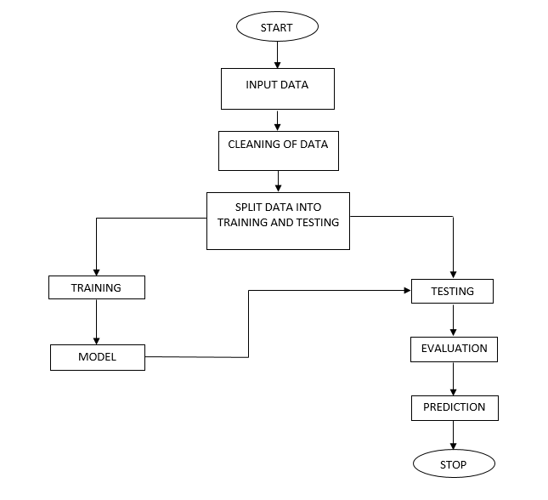
BLOCK DIAGRAM

Slide 11
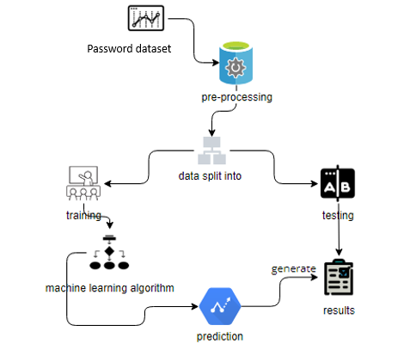
ARCHITECTURE

Slide 12
IMPLEMENTATION
First we have taken the UNSW_NB15 of CSV file.
Load the dataset into work environment and made a check for null values if any.
After checking the null values split the data in to train data and test data.
After splitting apply the algorithm and fit the train data and test data.
We got the best accuracy score of Decision Tree.
Later, the entire work is done with flask framework
User can view the Home, About, Login, Registration, User home page, Upload page, View page, Preprocessing, Model training, Prediction and Graph.
After detection, we will get to know that whether the Performance Analysis of Intrusion Detection Systems is Attacked are Not.

Slide 13
HARDWARE & SOFTWARE REQUIREMENTS
H/W Configuration:
• Processor - I3/Intel Processor
• Hard Disk -160GB
• RAM - 8Gb
S/W Configuration:
• Operating System : Windows 7/8/10 .
• IDE : Pycharm.
• Libraries Used : Numpy, Pandas, OS, Pillow, MySQL.
• Technology : Python 3.6+.

Slide 14
MODULES
1. System:
1.1 Store Dataset:
The System stores the dataset given by the user.
1.2 Model Training:
The system takes the data from the user and fed that data to the selected model.
1.3 Model Predictions:
The system takes the data given by the user and predict the output based on the given data.
1.4 Data Splitting:
Here the system can split the data into two parts for training and testing.

Slide 15
2. User:
2.1 Register:
Users can register for the Performance Analysis of Intrusion Detection Systems Using a Feature Selection Method application here.
2.2 Login:
After registering, the user can access his portal.
2.3 Load Dataset:
The user can upload the dataset he/she want to work on.
2.4 View Dataset:
The User can view the dataset.

Slide 16
2.5 Select model:
User can apply the model to the dataset for accuracy.
2.6 View results:
User can view the predicted results weather the system is attacked or not.

Slide 17
Algorithms
Decision Tree:
Decision tree learning is a supervised machine learning technique for inducing a decision tree from training data. A decision tree (also referred to as a classification tree or a reduction tree) is a predictive model which is a mapping from observations about an item to conclusions about its target value.
The goal of using a Decision Tree is to create a training model that can use to predict the class or value of the target variable by learning simple decision rules inferred from prior data (training data). In Decision Trees, for predicting a class label for a record we start from the root of the tree

Slide 18
K-Nearest Neighbour:
K-Nearest Neighbour is one of the simplest Machine Learning algorithms based on Supervised Learning technique.
K-NN algorithm assumes the similarity between the new case/data and available cases and put the new case into the category that is most similar to the available categories.
K-NN algorithm stores all the available data and classifies a new data point based on the similarity. This means when new data appears then it can be easily classified into a well suite category by using K- NN algorithm.
K-NN algorithm can be used for Regression as well as for Classification but mostly it is used for the Classification problems.
K-NN is a non-parametric algorithm, which means it does not make any assumption on underlying data.

Slide 19
It is also called a lazy learner algorithm because it does not learn from the training set immediately instead it stores the dataset and at the time of classification, it performs an action on the dataset.
KNN algorithm at the training phase just stores the dataset and when it gets new data, then it classifies that data into a category that is much similar to the new data.
Example: Suppose, we have an image of a creature that looks similar to cat and dog, but we want to know either it is a cat or dog. So for this identification, we can use the KNN algorithm, as it works on a similarity measure. Our KNN model will find the similar features of the new data set to the cats and dogs images and based on the most similar features it will put it in either cat or dog category.

Slide 20
LOGISTIC REGRESSION:
Logistic Regression was used in the biological sciences in early twentieth century. It was then used in many social science applications. Logistic Regression is used when the dependent variable (target) is categorical. For example,
To predict whether an email is spam (1) or (0)
Whether the tumor is malignant (1) or not (0)
Consider a scenario where we need to classify whether an email is spam or not. If we use linear regression for this problem, there is a need for setting up a threshold based on which classification can be done. Say if the actual class is malignant, predicted continuous value 0.4 and the threshold value is 0.5, the data point will be classified as not malignant which can lead to serious consequence in real time.
From this example, it can be inferred that linear regression is not suitable for classification problem. Linear regression is unbounded, and this brings logistic regression into picture. Their value strictly ranges from 0 to 1.

Slide 21
Neural Networks:
An artificial neural network (ANN) is the piece of a computing system designed to simulate the way the human brain analyzes and processes information. It is the foundation of artificial intelligence (AI) and solves problems that would prove impossible or difficult by human or statistical standards. ANNs have self-learning capabilities that enable them to produce better results as more data becomes available.
An ANN has hundreds or thousands of artificial neurons called processing units, which are interconnected by nodes. These processing units are made up of input and output units. The input units receive various forms and structures of information based on an internal weighting system, and the neural network attempts to learn about the information presented to produce one output report. Just like humans need rules and guidelines to come up with a result or output, ANNs also use a set of learning rules called backpropagation, an abbreviation for backward propagation of error, to perfect their output results.

Slide 22
XGBoost
XGBoost stands for “Extreme Gradient Boosting”. XGBoost is an optimized distributed gradient boosting library designed to be highly efficient, flexible and portable. It implements Machine Learning algorithms under the Gradient Boosting framework. It provides a parallel tree boosting to solve many data science problems in a fast and accurate way.
Boosting
Boosting is an ensemble learning technique to build a strong classifier from several weak classifiers in series. Boosting algorithms play a crucial role in dealing with Bias-variance trade-off. Unlike bagging algorithms, which only controls for high variance in a model, boosting controls both the aspects (bias & variance) and is considered to be more effective. Below are the few types of boosting algorithms:
AdaBoost (Adaptive Boosting)
Gradient Boosting
XGBoost
CatBoost
Light GBM

Slide 23
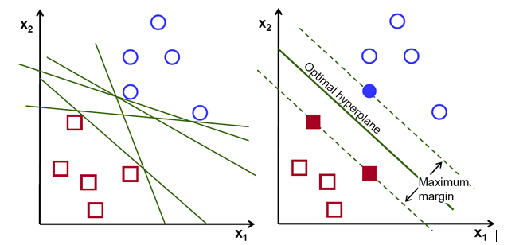
SUPPORT VECTOR MACHINES:
The objective of the support vector machine algorithm is to find a hyper plane in an N-dimensional space (N — the number of features) that distinctly classifies the data points.

Slide 24
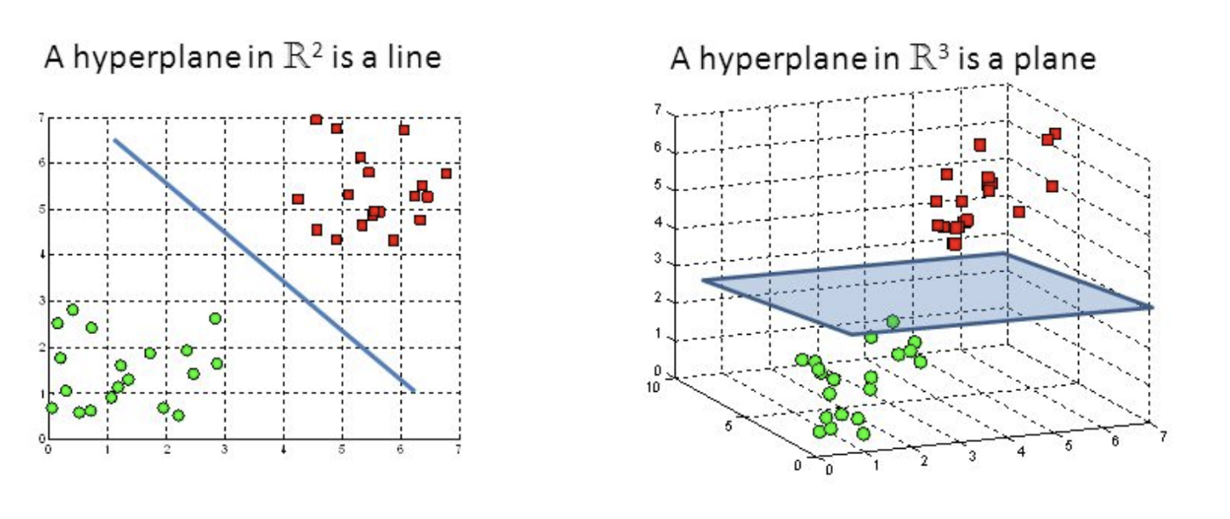
Possible hyper planes :
To separate the two classes of data points, there are many possible Hyper planes that could be chosen. Our objective is to find a plane that has the maximum margin, i.e. the maximum distance between data points of both classes. Maximizing the margin distance provides some reinforcement so that future data points can be classified with more confidence.

Slide 25
UML Diagrams
Uml stands for unified modeling language. Uml is a standardized general-purpose modeling language in the field of object-oriented software engineering. The standard is managed, and was created by, the object management group.
The goal is for uml to become a common language for creating models of object oriented computer software. In its current form uml is comprised of two major components: a meta-model and a notation. In the future, some form of method or process may also be added to; or associated with, uml.
The unified modeling language is a standard language for specifying, visualization, constructing and documenting the artifacts of software system, as well as for business modeling and other non-software systems.
The uml represents a collection of best engineering practices that have proven successful in the modeling of large and complex systems.
The uml is a very important part of developing objects oriented software and the software development process. The uml uses mostly graphical notations to express the design of software projects.

Slide 26
Use case diagram:
A use case diagram in the unified modeling language (uml) is a type of behavioral diagram defined by and created from a use-case analysis. Its purpose is to present a graphical overview of the functionality provided by a system in terms of actors, their goals (represented as use cases), and any dependencies between those use cases. The main purpose of a use case diagram is to show what system functions are performed for which actor. Roles of the actors in the system can be depicted.

Slide 27
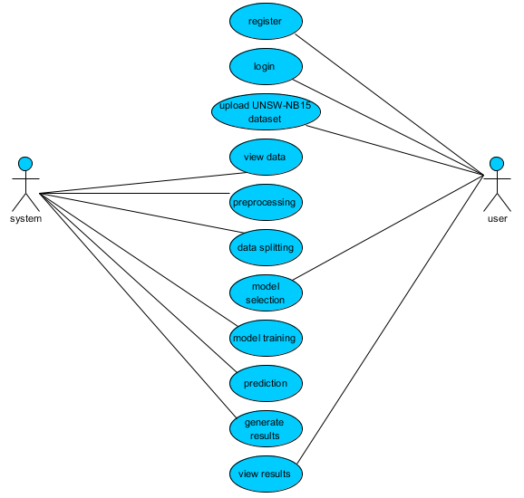

Slide 28
Class diagram:
In software engineering, a class diagram in the unified modeling language (uml) is a type of static structure diagram that describes the structure of a system by showing the system's classes, their attributes, operations (or methods), and the relationships among the classes. It explains which class contains information.

Slide 29
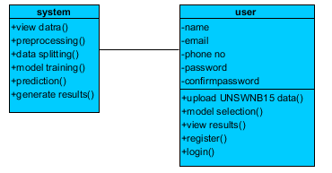

Slide 30
Sequence diagram:
A sequence diagram in unified modeling language (uml) is a kind of interaction diagram that shows how processes operate with one another and in what order. It is a construct of a message sequence chart. Sequence diagrams are sometimes called event diagrams, event scenarios, and timing diagrams.

Slide 31
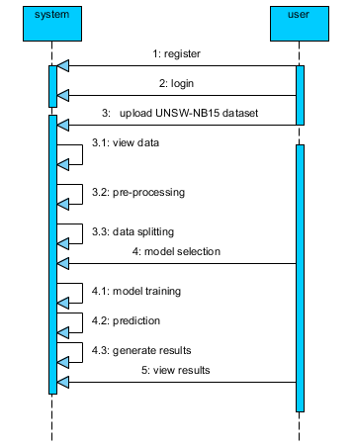

Slide 32
Collaboration diagram:
In collaboration diagram the method call sequence is indicated by some numbering technique as shown below. The number indicates how the methods are called one after another. We have taken the same order management system to describe the collaboration diagram. The method calls are similar to that of a sequence diagram. But the difference is that the sequence diagram does not describe the object organization whereas the collaboration diagram shows the object organization.

Slide 33
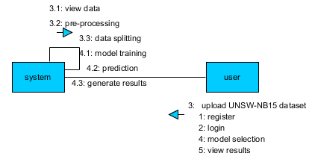

Slide 34
Deployment diagram:
Deployment diagram represents the deployment view of a system. It is related to the component diagram. Because the components are deployed using the deployment diagrams. A deployment diagram consists of nodes. Nodes are nothing but physical hard ware’s used to deploy the application.

Slide 35


Slide 36
Component diagram:
Component diagrams are used to describe the physical artifacts of a system. This artifact includes files, executable, libraries etc. So the purpose of this diagram is different, component diagrams are used during the implementation phase of an application. But it is prepared well in advance to visualize the implementation details. Initially the system is designed using different uml diagrams and then when the artifacts are ready component diagrams are used to get an idea of the implementation.

Slide 37
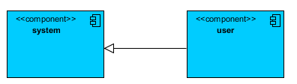

Slide 38
Activity diagram:
Activity diagrams are graphical representations of workflows of stepwise activities and actions with support for choice, iteration and concurrency. In the unified modeling language, activity diagrams can be used to describe the business and operational step-by-step workflows of components in a system. An activity diagram shows the overall flow of control.

Slide 39
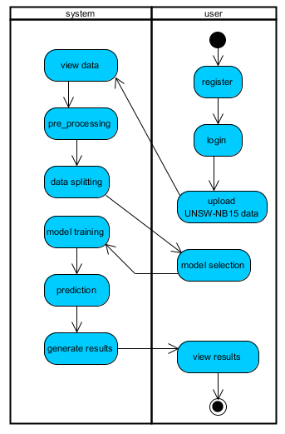

Slide 40
ER Diagram:
An Entity–relationship model (ER model) describes the structure of a database with the help of a diagram, which is known as Entity Relationship Diagram (ER Diagram). An ER model is a design or blueprint of a database that can later be implemented as a database. The main components of E-R model are: entity set and relationship set.

Slide 41
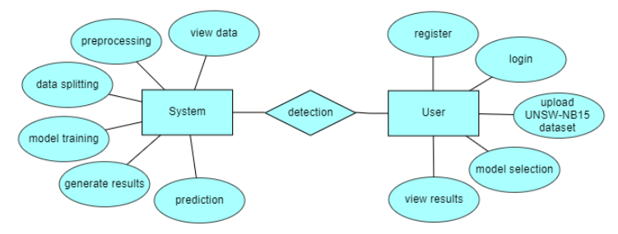

Slide 42
DFD Diagram:
A Data Flow Diagram (DFD) is a traditional way to visualize the information flows within a system. A neat and clear DFD can depict a good amount of the system requirements graphically. It can be manual, automated, or a combination of both. It shows how information enters and leaves the system, what changes the information and where information is stored. The purpose of a DFD is to show the scope and boundaries of a system as a whole. It may be used as a communications tool between a systems analyst and any person who plays a part in the system that acts as the starting point for redesigning a system.

Slide 43

Context Level Diagram:

Slide 44
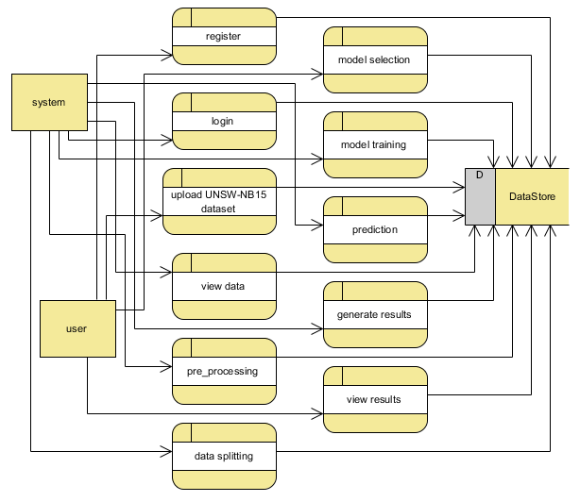
Level 1 Diagram:

Slide 45
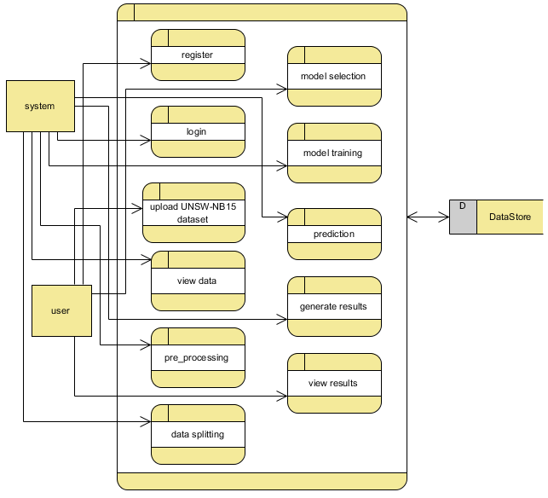
Level 2 Diagram:

Slide 46

OUTPUT SCREEN SHOTS WITH DESCRIPTION.
Home Page:
Here user view the home page of Performance Analysis of Intrusion Detection Systems Using a Feature Selection Method web appellation.
Fig2: Home Page

Slide 47
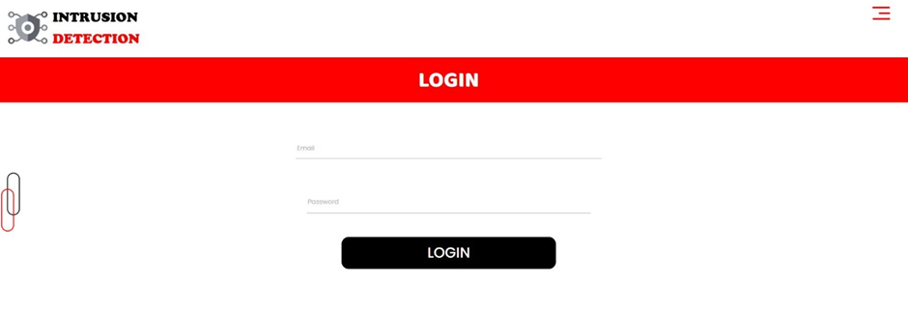
About:
In the about page, users can learn more about Performance Analysis of Intrusion Detection Systems Using a Feature Selection Method.
Fig4: Login.

Slide 48
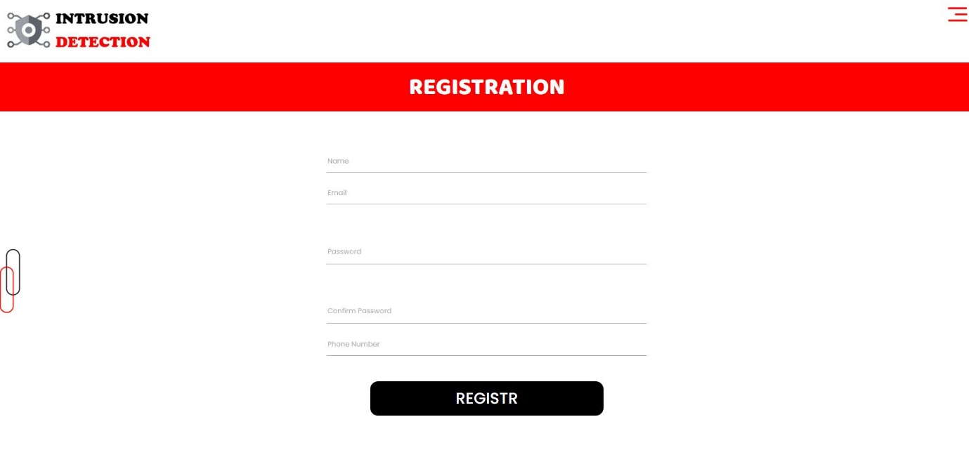
Registration:
Fig5: Registration.

Slide 49
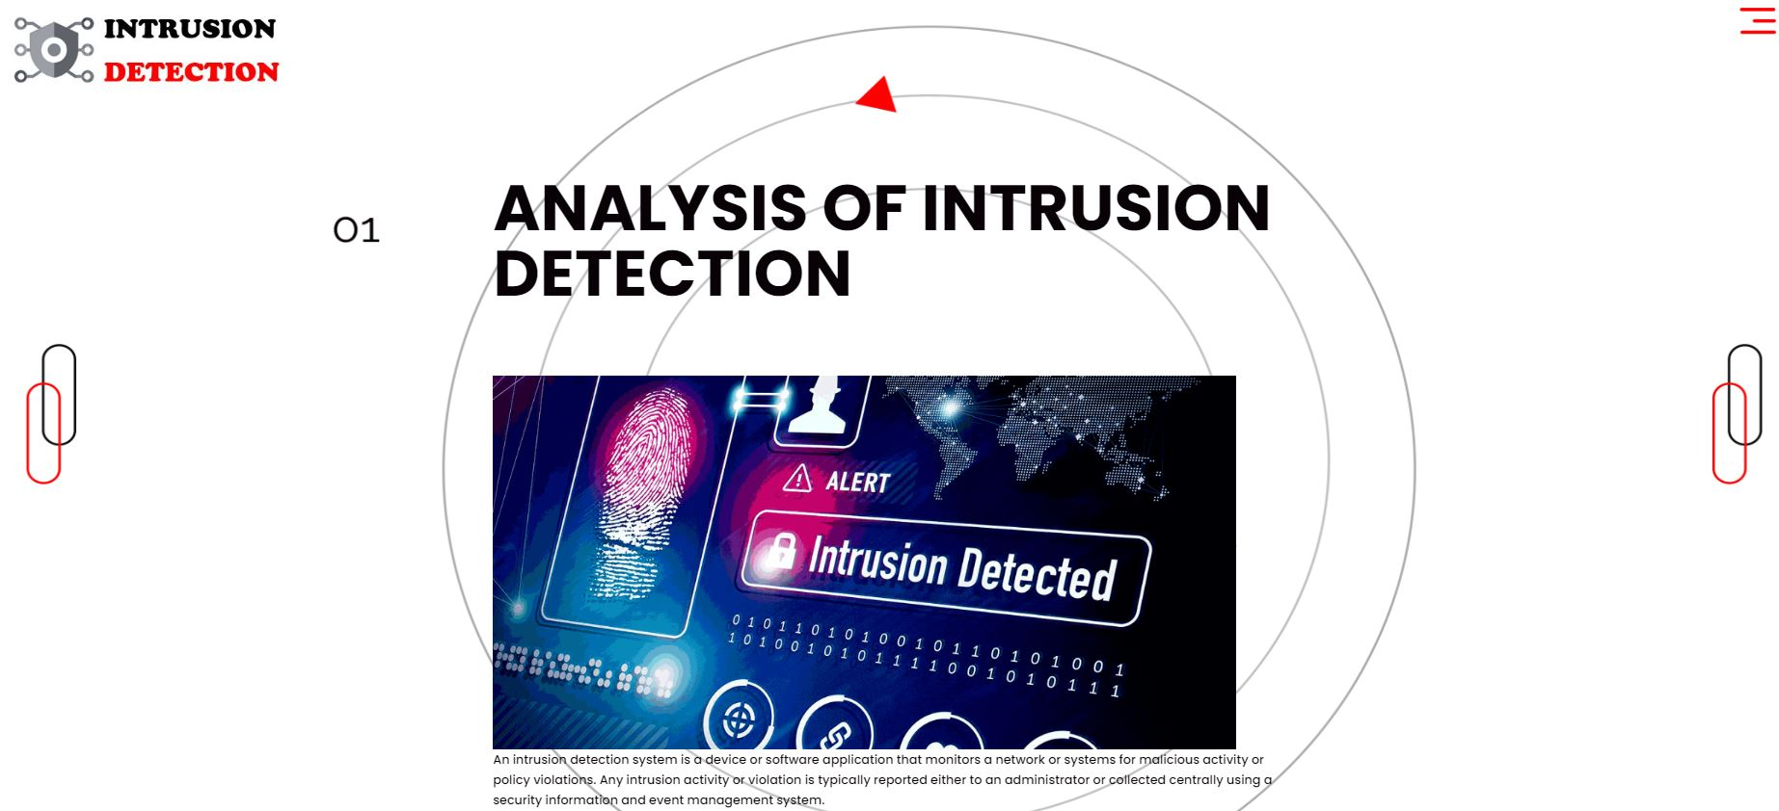
User Home Page:
Fig6: User Home page.

Slide 50
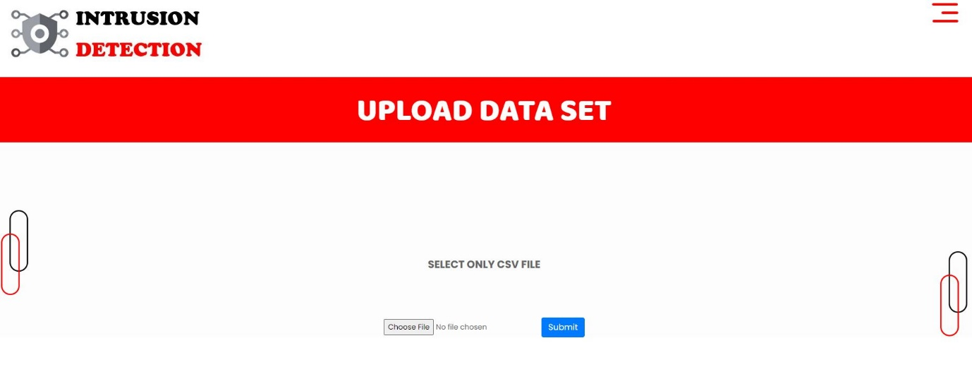
Upload Data Set:
Fig7: Upload dataset.

Slide 51
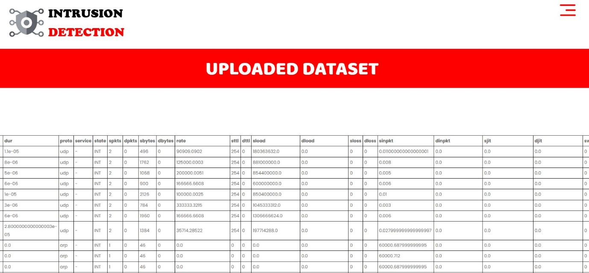
View:
Fig8: View.

Slide 52
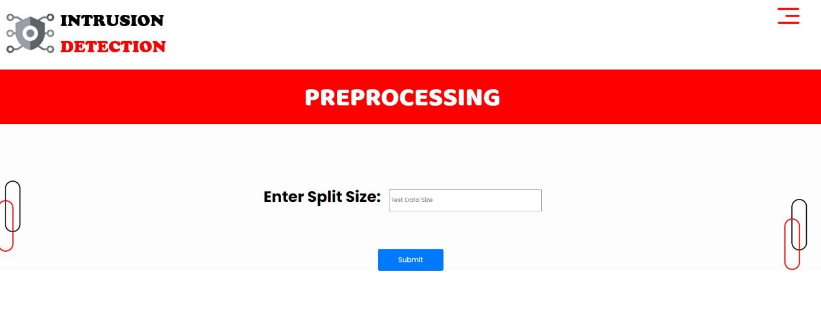
Preprocessing:
Fig9: Preprocessing

Slide 53
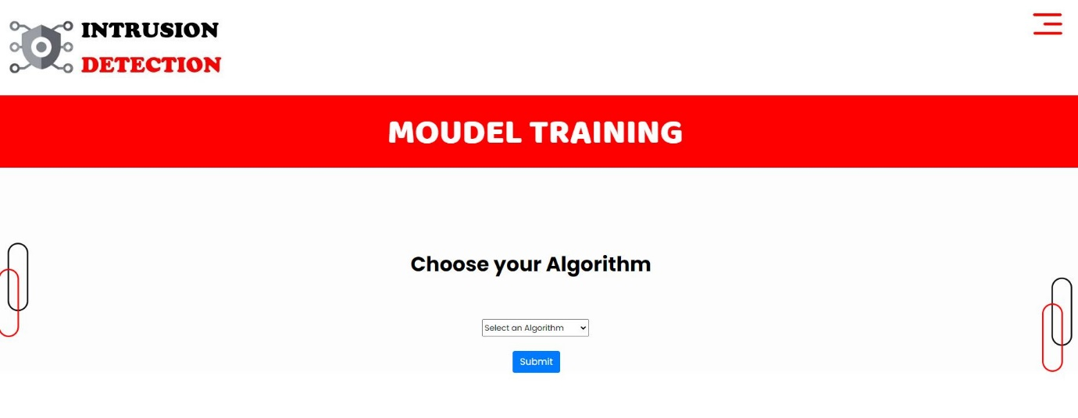
Training:
We’re training the algorithm to see which one has the best accuracy.
Fig10: Training Algorithm

Slide 54
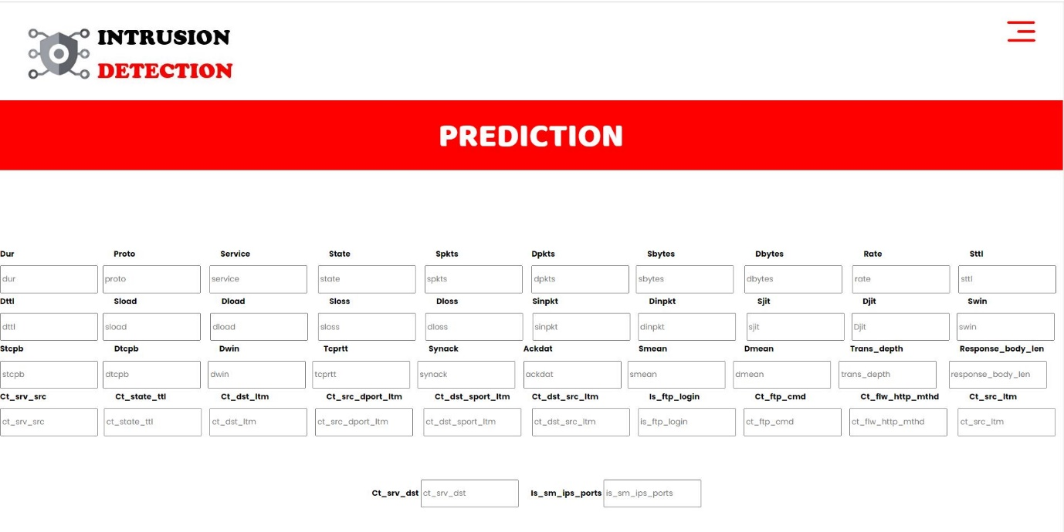
Prediction:
This page show Performance Analysis of Intrusion Detection Systems Using a Feature Selection
Method will predict Normal are attack.
Fig11: Prediction

Slide 55
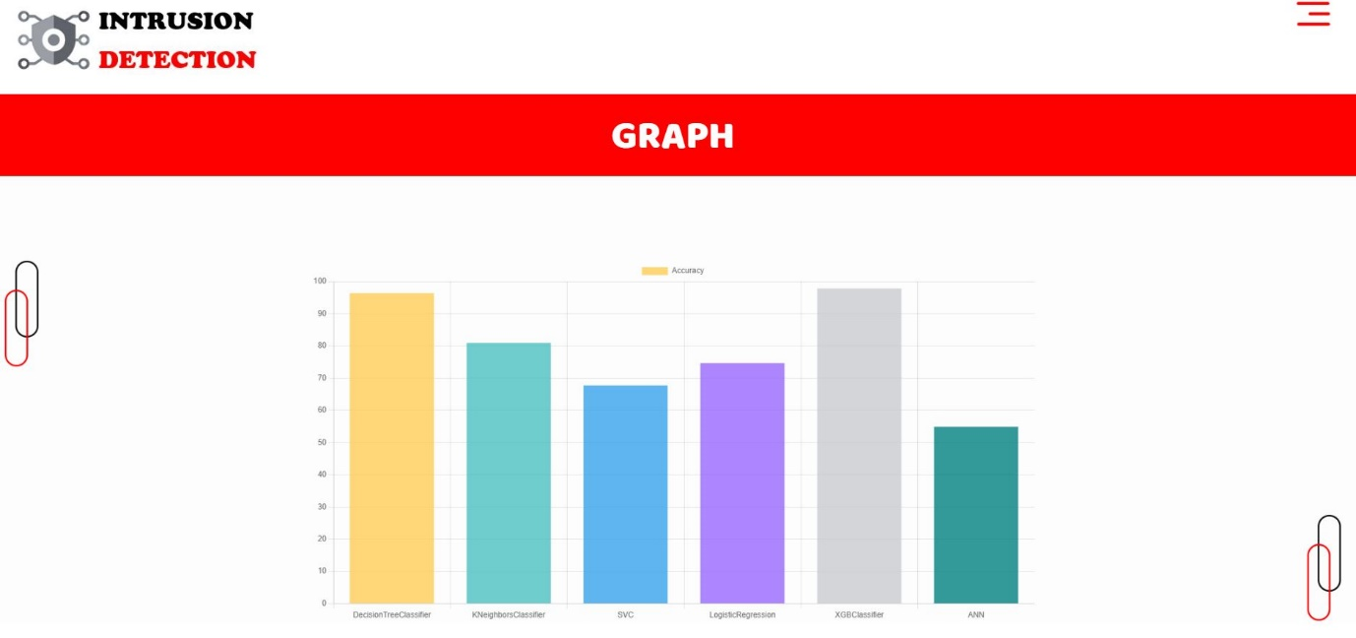
Graph:
Fig12: Graph.

Slide 56
CONCLUSION
In this project, we have developed a user friendly application called Performance Analysis of Intrusion Detection Systems Using a Feature Selection Method using Machine learning techniques such as Decision Tree, Logistic Regression, XGBoost, K-Nearest Neighbour (KNN) we used the best techniques we found and it’s show the whether the performance of the system is attacked or not.

Slide 57
REFERENCES
Ribeiro J, Saghezchi FB, Mantas G, Rodriguez J, Abd-Alhameed RA. Hidroid: prototyping a behavioral host-based intrusion detection and prevention system for android. IEEE Access. 2020;8:23154–168.
Van NTT, Thinh TN. Accelerating anomaly-based IDS using neural network on GPU. In: 2015 international conference on advanced computing and applications (ACOMP). IEEE; 2015. pp. 67–74.
Jabez J, Muthukumar B. Intrusion detection system (IDS): anomaly detection using outlier detection approach. Procedia Comput Sci. 2015;48:338–46.
Neelakantan S, Rao S. A threat-aware anomaly-based intrusion-detection approach for obtaining network-specifc useful alarms. In: International conference on distributed computing and networking. Springer. 2009; pp. 175–180.

